Slide 1
An AI Approach for Detection of Trees from Leaves Using Deep learning

Slide 2
problem
The identification of plant species is fundamental for the effective study and management of biodiversity.
In a manual identification process, different characteristics of plants are measured as identification keys which are examined sequentially and adaptively to identify plant species. This manual identification can also lead to errors, as it can be difficult to accurately match those characteristics to those described in reference materials.
Moreover, the manual identification of plant species is a time-consuming process and requires a lot of expertise in the field, especially when dealing with large numbers of plants or unfamiliar species

Slide 3
PROPOSED SOLUTION
Automated identification systems based on computer vision and machine learning techniques provide an alternative and assistive approach for this task.
The proposed Deep Learning (DL) model consists of a CNN block for feature extraction and a classifier block for classifying the extracted features.
The model will be able to identify plant species when given an image of its leaves.

Slide 4
DATASET
MalayaKew Dataset
MalayaKew (MK) Leaf dataset was collected at the Royal Botanic Gardens, Kew, England.
It consists of scan-like images of leaves from 44 species classes. This dataset is very challenging as leaves from different species classes have very similar appearance.
Reference Link: https://web.fsktm.um.edu.my/~cschan/downloads_MKLeaf_dataset.html
Download Link: https://drive.google.com/file/d/1styqhycZvZxjH2Jv0HhuQH2eJT_IS-1A/view?usp=sharing

Slide 5
Tech Stack
TensorFlow: TensorFlow is an open-source machine learning library for building and deploying neural networks. It provides a wide range of tools and resources for building, training, and evaluating CNN models.
Python: Python is a popular programming language that is widely used in machine learning and data science.
Azure: Azure is a cloud computing platform and service offered by Microsoft.

Slide 6
Why cnn?
1. Convolutional Neural Network (CNN) is the best algorithm and is known for its ability to achieve high accuracy in image classification tasks.
2. CNN’s built-in convolutional layers reduce the higher dimensionality of images without losing any information.
3. It has the ability to extract unique features from image data to give an accuracy score.
4. It reduces the chance of overfitting which automatically detects the important features without any human supervision.
5.CNNs can handle large datasets of images, which can be important when working with a diverse set of medicinal plants.

Slide 7
COMPARISON of ALL TRAINED mOdel
EFFICIENTNET B0 : Validation accuracy is 95%
XCEPTION : Validation accuracy is 86%
INCEPTION V3 : Validation Accuracy is 95%

Slide 8
EfficientnetB0
EfficientNetB0 is a convolutional neural network architecture that is designed to be computationally efficient while achieving high accuracy on image classification tasks.
It is based on a compound scaling technique that scales the width, depth, and resolution of the network to find the optimal balance between model complexity and performance.
EfficientNetB0 has approximately 5.3 million parameters, which makes it the smallest variant in the EfficientNet family.
EfficientNetB0 has achieved state-of-the-art accuracy on benchmark datasets such as ImageNet.
EfficientNetB0 is widely used in computer vision tasks such as object detection, segmentation, and transfer learning.

Slide 9
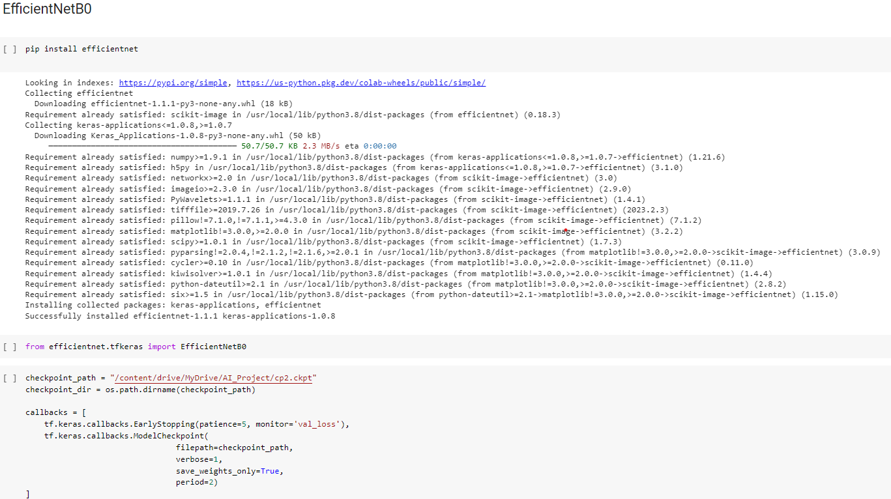
DATA TRAINING WITH EFFICIENTNETB0

Slide 10
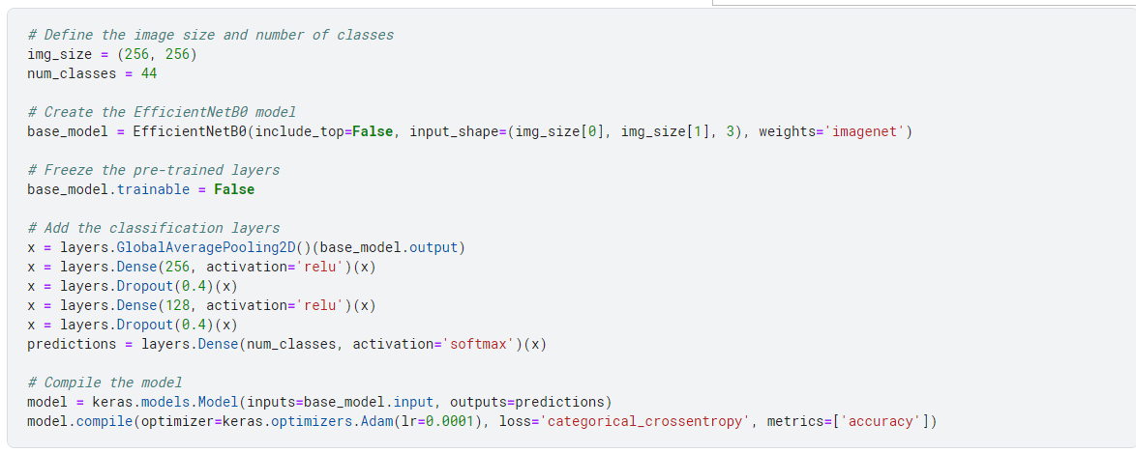

Slide 11
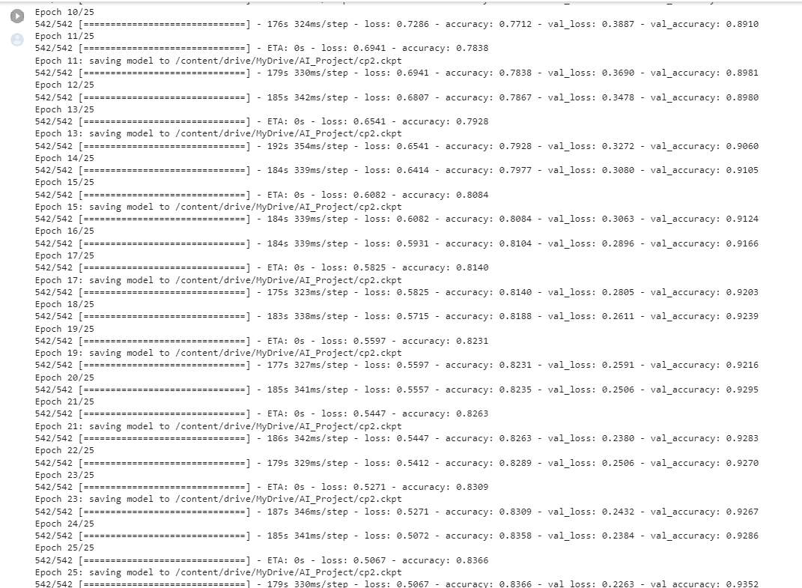

Slide 12
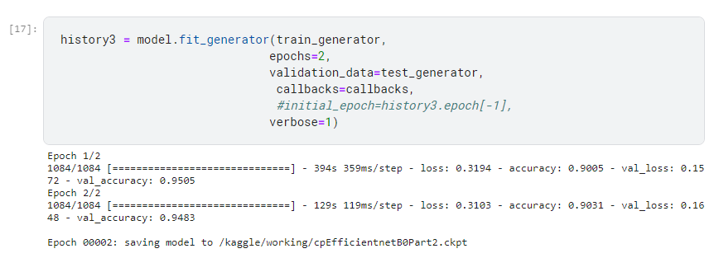

Slide 13
InceptionV3
InceptionV3 is a convolutional neural network architecture that was introduced by Szegedy et al. from Google Research in their 2015 paper "Rethinking the Inception Architecture for Computer Vision".
It is an improvement over the previous Inception models, with better accuracy and computational efficiency, achieved through the use of multiple smaller convolutions rather than one large convolution.
InceptionV3 consists of a deep neural network with 48 layers, and its design includes inception modules, which are small sub-networks that allow the network to capture both local and global features.
InceptionV3 has been trained on large datasets such as ImageNet and has achieved state-of-the-art performance on several benchmark datasets, including the ImageNet Large Scale Visual Recognition Challenge.

Slide 14
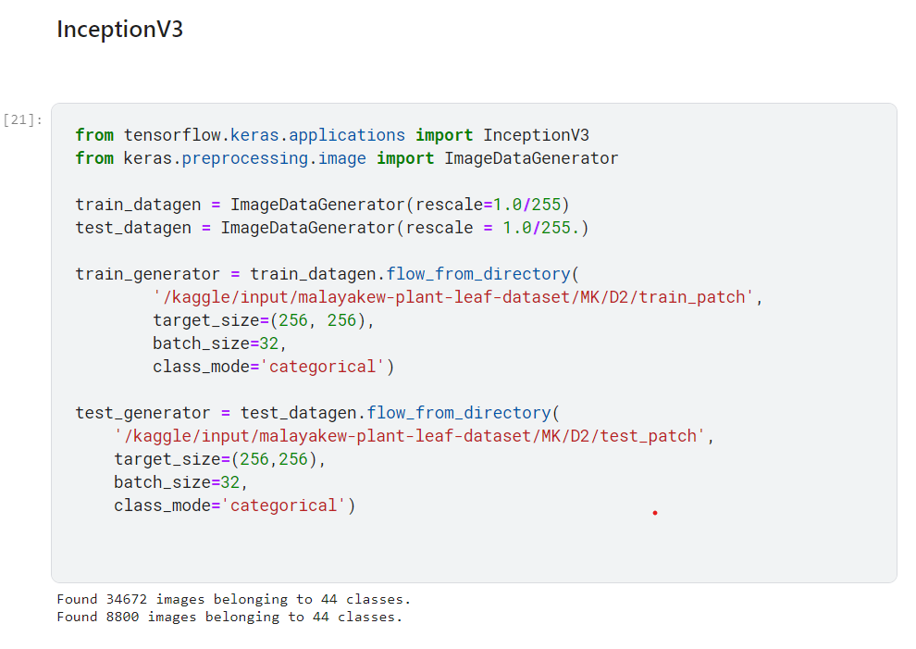
DATA TRAINING WITH InceptionV3

Slide 15
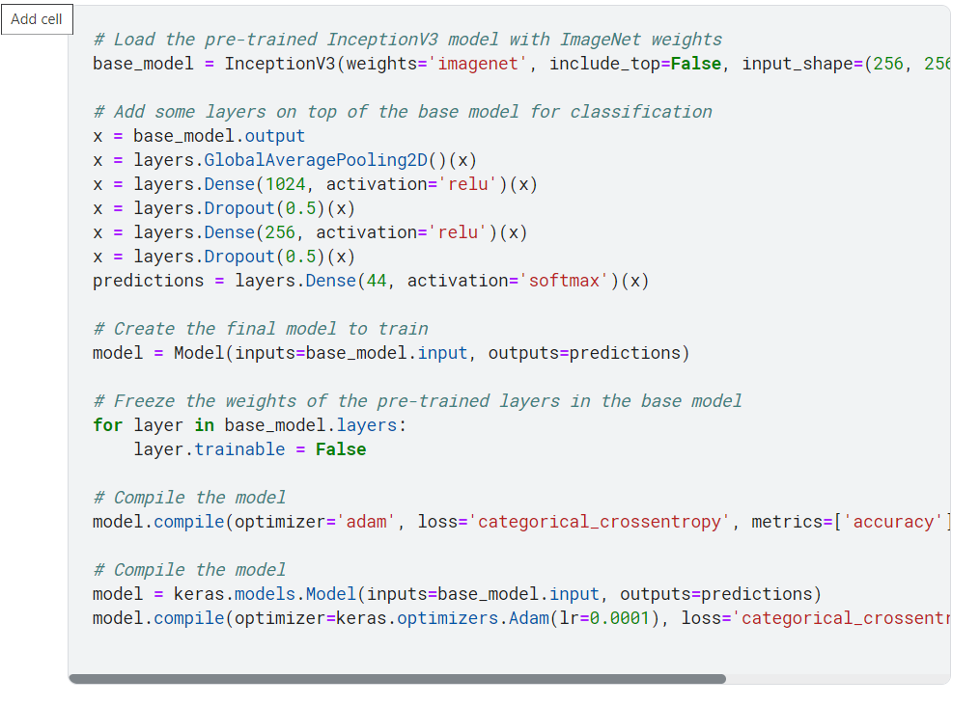

Slide 16
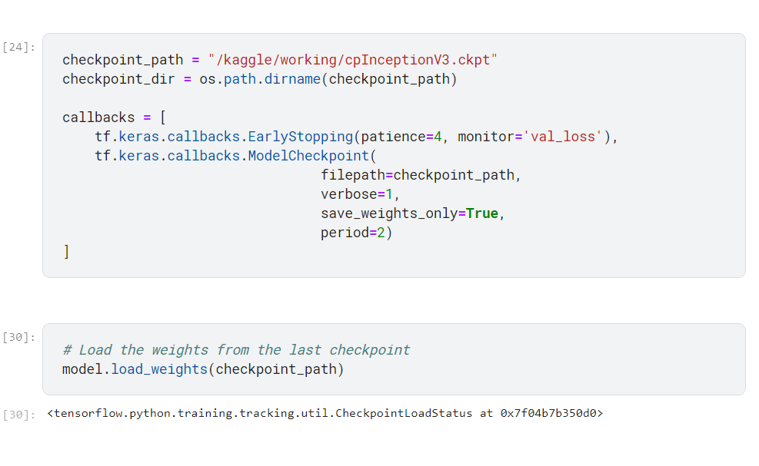

Slide 17
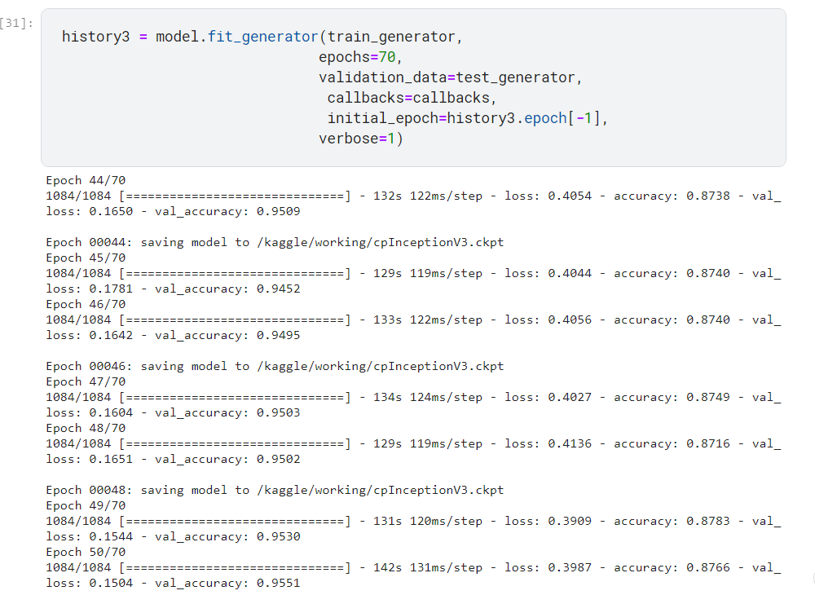

Slide 18
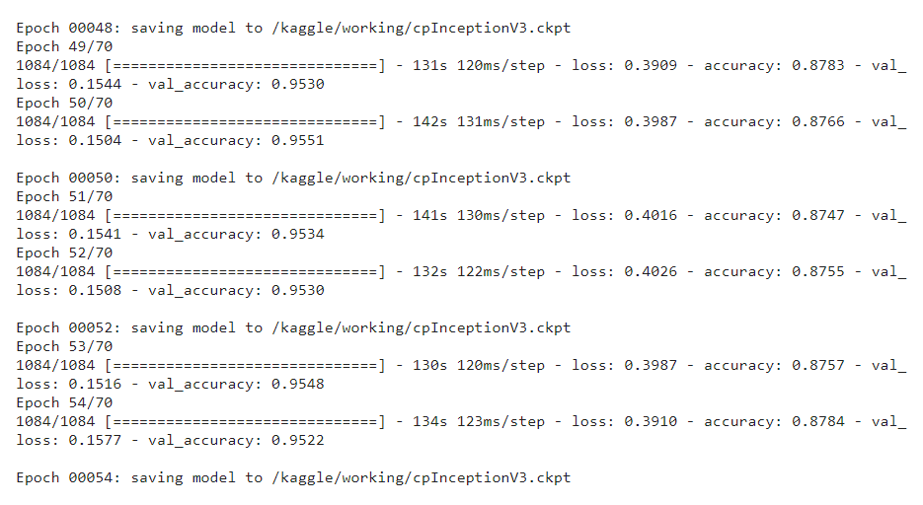

Slide 19
Xception
Xception is a deep convolutional neural network architecture that was introduced by François Chollet in 2016. It is based on the Inception architecture, but with a modified convolutional block design that allows for more efficient and accurate feature extraction.
Xception has achieved state-of-the-art performance on several benchmark image classification datasets, including the ImageNet dataset. This makes it a strong candidate for transfer learning applications in a variety of domains.
Xception consists of 36 convolutional layers, divided into 14 modules, followed by two fully connected layers for classification.

Slide 20
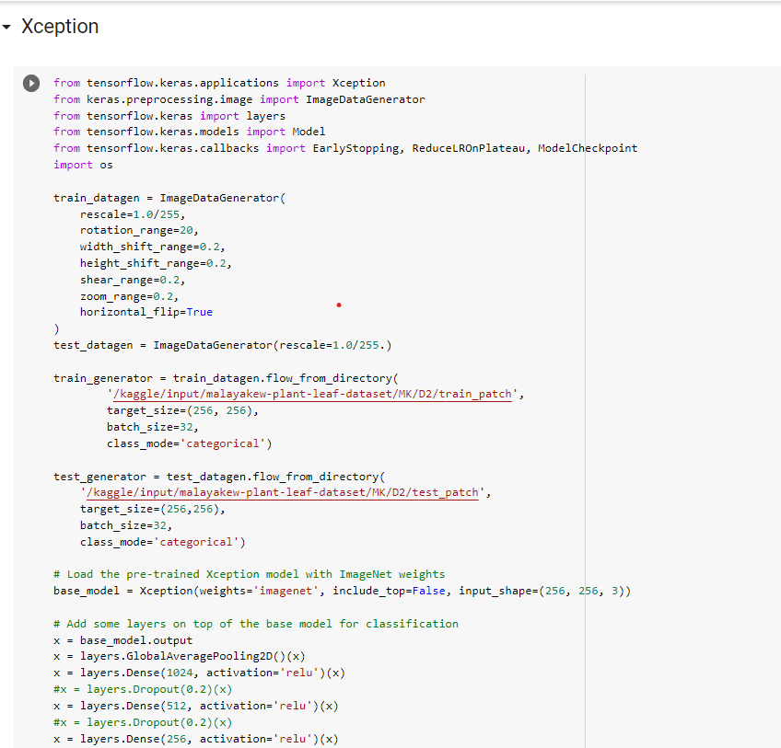
DATA Training with XCEPTION

Slide 21
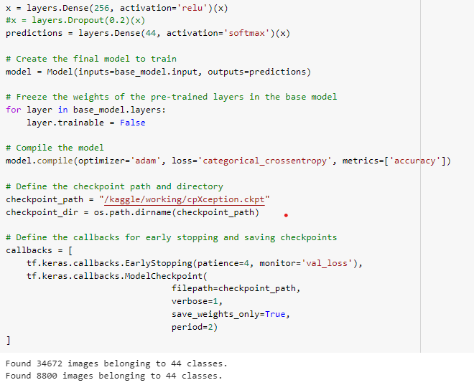
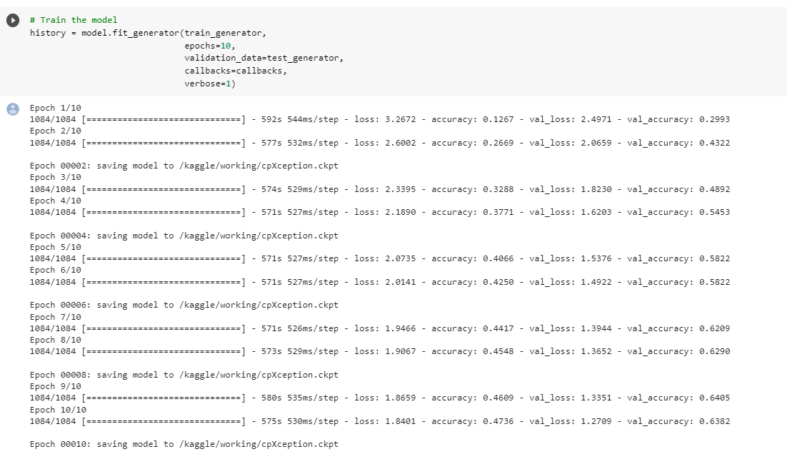

Slide 22
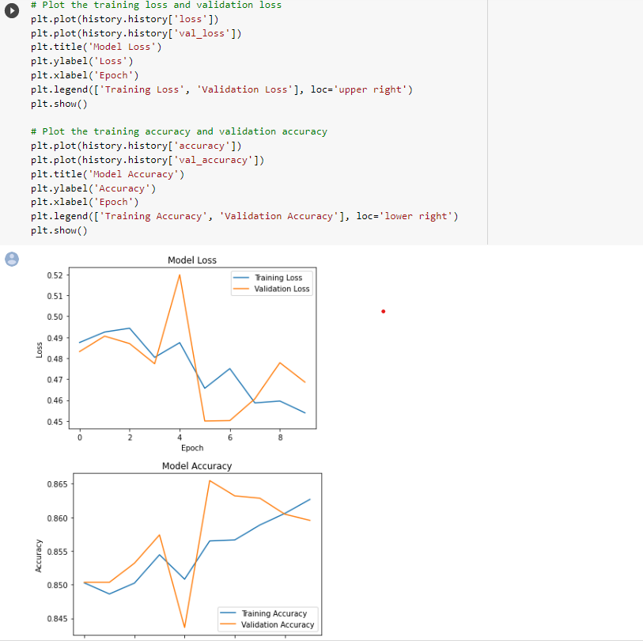
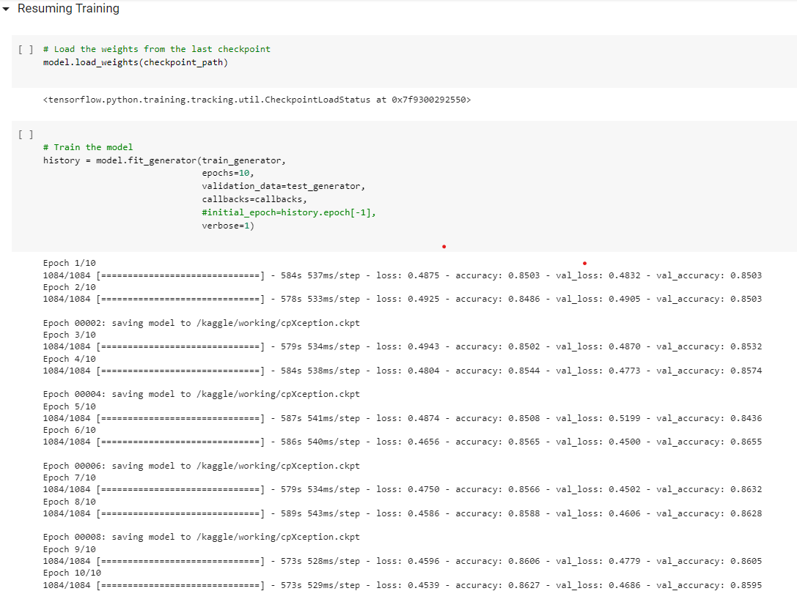

Slide 23


Slide 24


Slide 25
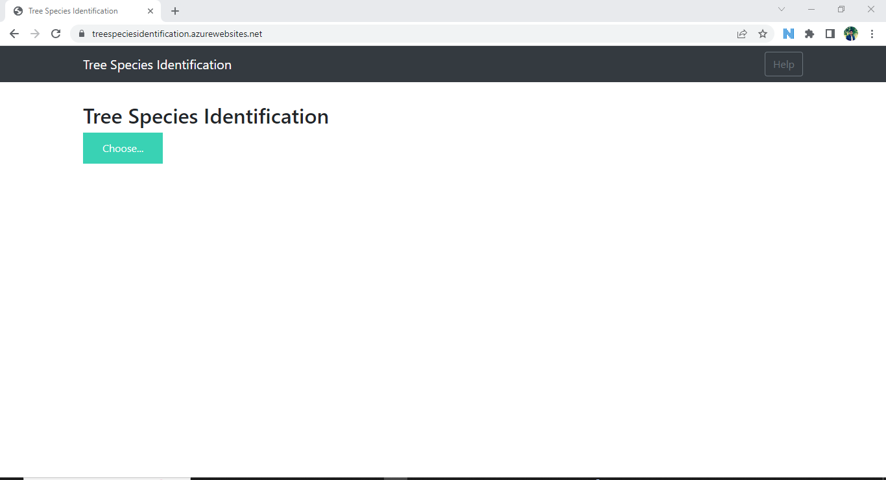

Slide 26
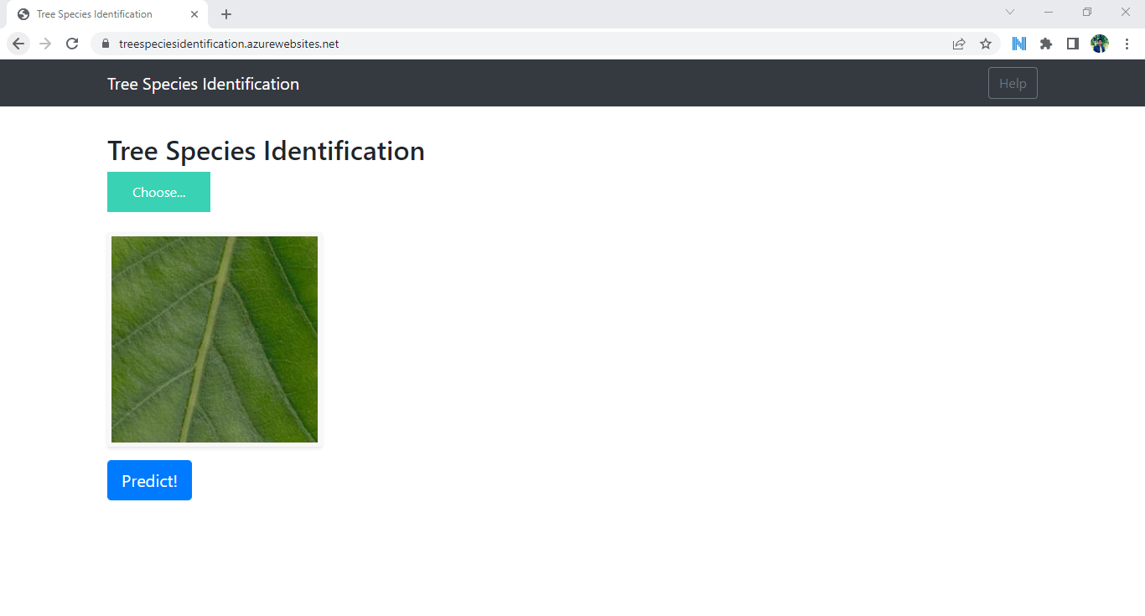

Slide 27
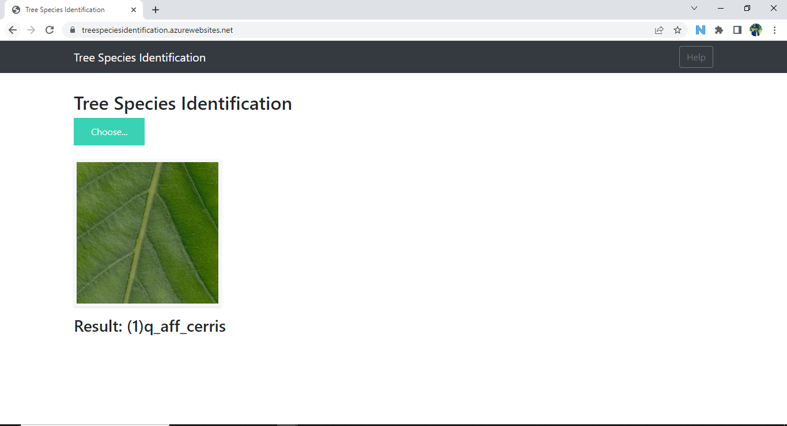

Slide 28
FUTURE ENHANCEMENT
Make the model more useful by adding data about other species which are not included in the 44 species used in this model.
Try different combinations of hyperparameters to improve the accuracy of the model.

Slide 29
THE END

